Slide 1



Discuss how social and environmental variables may affect cognitive development

Slide 2

Cognitive development is affected by a number of social and environmental variables that interact with the child’s genetic inheritance in complex ways that are not yet fully understood.

Slide 3



Stimulation, adequate nutrition, and parental nurturance are important factors in brain development and therefore also in developing cognitive competence.

Slide 4

Social Variables

Slide 5



Socioeconomic Status
(SES)
SES is a total measure of a person’s social and economic position based on income, education, and occupation.

Slide 6

SES
SES has been found to correlate with parenting (social variable) and environmental enrichment (environmental variable).

Slide 7


What researchers have found comparing SES to cognition….
Farah (2005) found that low SES children performed worse on all tests of cognitive performance compared to middle SES children.

Slide 8


What researchers have found comparing SES to cognition….
Findings from neuroscientists show that children growing up in very poor families experience high levels of stress and this could impair brain development and general cognitive functioning.

Slide 9

Krugman (2008) argued that children born to poor parents (low SES) have a 50% chance of remaining in lifelong poverty because the brains of poor children do not develop optimally and they therefore miss social and economic opportunities.

Slide 10


SES/Malnutrition/Cognitive Development
One effect of poverty is chronic malnourishment, which is linked to less activity and interest in learning.
Malnutrition is associated with impaired or delayed brain development.
A number of cognitive deficits have been reported in malnourished children.

Slide 11
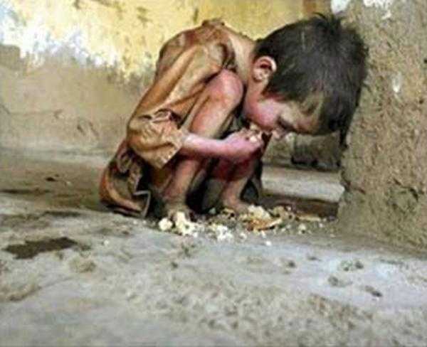

Bhoomika
studied the effect of malnutrition on cognitive performance in a sample of 20 Indian children in two age groups, one aged from five to seven and another aged between eight and ten.
The data was compared to those in a control group

Slide 12

Bhoomika
Malnourished children in both age groups scored lover in tests of attention, working memory, and visuospatial tasks.
Older children showed less cognitive impairment, which suggests that the effects of malnutrition on cognitive competence may result in delayed cognitive development during childhood but it is not a permanent generalized cognitive impairment.

Slide 13
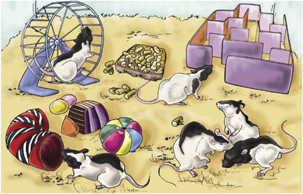
Environmental Variables
Animal research suggests that there is a specific relationship between early experience and brain development.
Rosenzweig & Bennet

Slide 14
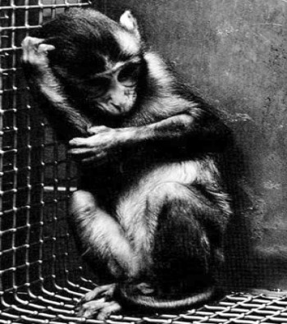
Animal research has also demonstrated that stress (e.g. due to maternal separation) interferes with normal brain development.
Harry Harlow
This kind of research cannot take place using humans for ethical reasons.

Slide 15

Oxana Malaya

Slide 16



It is perhaps not possible to generalize directly to humans from animal research but it is possible to measure some of the same naturally occurring variables in human experiences (e.g. neglect and institutionalization) known to be related to cognitive function.

Slide 17

Martha Farah et al. (2008)
Aim:
To investigate the relationship between environmental stimulation and parental nurturance on cognitive development.

Slide 18

Farah
Procedure
This was a longitudinal design with 110 African-American middle-school children (mean age 11.8 years).
Children were recruited at birth and evaluated at age four and eight years in the home.

Slide 19


Farah
Interviews and observational checklists were used to measure environmental stimulation (e.g. variety of experience, encouragement to learn colors', music, and art) and parental nurturance (e.g. warmth and affection, emotional and verbal responsively, and paternal involvement).
The researchers also performed cognitive tests on language and memory in the laboratory.

Slide 20


Farah
Results
There was a positive correlation between environmental stimulation and language development.
Age was also a factor.
There was also a positive correlation between parental nurturance and long-term memory performance.

Slide 21

Evaluation
The data shows the importance of environmental and social factors in cognitive development although it is not possible to establish a cause-effect relationship since the study did not manipulate variables.
The children in this sample were from a low economic status and the sample is not representative, although 17% of American children live below the poverty line according to the 2004 census.
Low SES is associated with a number of adverse factors that can affect cognitive development, (e.g. physical and mental health problems, social and psychological stress, and poverty.
Email: mfarah@neuroethics.upenn.edu
Phone: (215) 573-3531

