Slide 1
Discuss factors related to overeating and the development of obesity

Slide 2

Obesity
Obesity is a growing health problem worldwide, including among children.
According to the WHO (2004) obesity has reached epidemic proportions globally and problems with being overweight are now affecting more people than malnutrition and hunger.
Discuss factors related to overeating and the development of obesity

Slide 3
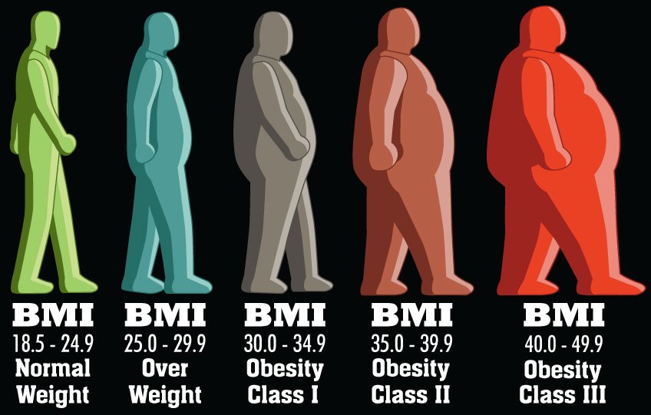
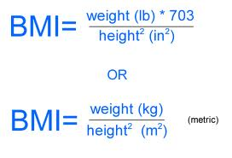
BMI
The most frequently used definition of obesity is related to body mass index (BMI), which is a measure of excess body fat.
BMI is a person’s weight (in kilograms) divided by the square of his or her height (in meters).
Discuss factors related to overeating and the development of obesity

Slide 4
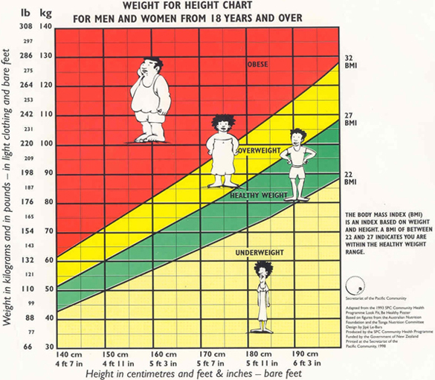
BMI
Normal weight BMI 20–24.9
Overweight BMI 25–29.9
Clinical obesity BMI 30–39.9
Severe obesity BMI 40
Discuss factors related to overeating and the development of obesity

Slide 5
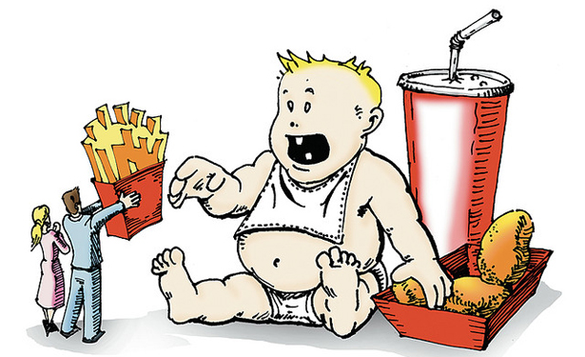
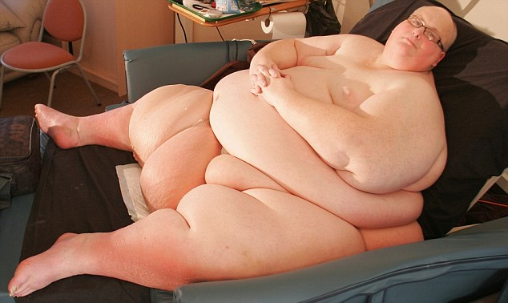
Biological factors of Obesity
Discuss factors related to overeating and the development of obesity

Slide 6
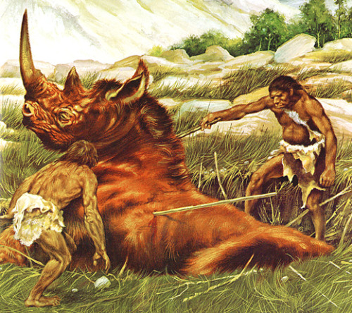
Evolution
The early humans were hunter-gatherers who lived as nomads for millions of years.
Homo Sapiens appeared some 130,000 to 100,000 years BC and their bodies were adapted to the hardship of nomadic life.
Discuss factors related to overeating and the development of obesity

Slide 7
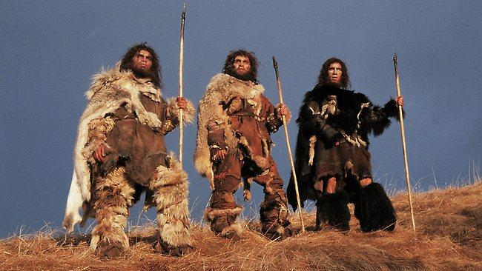

Evolution
Our ancestors’ diet was varied and the body’s ability to store fat easily was advantageous for survival.
The huntergatherers needed the fat to survive winters and the long journeys in search of food.
Discuss factors related to overeating and the development of obesity

Slide 8


Evolution
The demand for energy was much higher than it is in modern societies with a sedentary lifestyle.
The genetic predisposition to store fat could thus be a disadvantage today where food is abundant and people are no longer as physically active.
The theory makes sense since it is at this point in human history that obesity is so frequent but it is impossible to test evolutionary theories.
Discuss factors related to overeating and the development of obesity

Slide 9
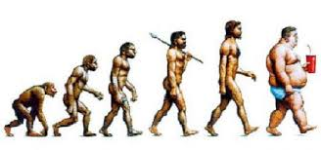

Slide 10


Genetic predisposition
Stunkard et al. (1990) performed a twin study based on 93 pairs of identical twins reared apart.
The researchers compared the twins’ BMI and found that genetic factors accounted for 66–70% of the variance in their body weight.
Discuss factors related to overeating and the development of obesity

Slide 11
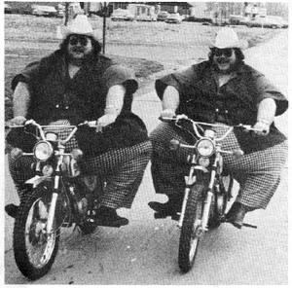
Genetic predisposition
The results indicate a strong genetic component in development of obesity but it is not really clear how genes operate here.
One theory is that metabolism rates could be genetically determined but the evidence is still inconclusive.
Another suggestion relates to the amount of fat cells in the individual.
Discuss factors related to overeating and the development of obesity

Slide 12
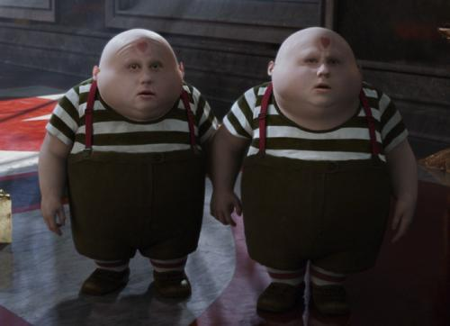

Genetic predisposition
The obesity epidemic cannot be explained by genetic factors alone.
Environmental factors play an important role (e.g. sedentary lifestyle and high energy foods).
The increase in prevalence rates of obesity within the last 20 years has taken place over too short a period for the genetic makeup of the population to have changed substantially.
Discuss factors related to overeating and the development of obesity

Slide 13

The neurobiology of food addiction
(the theory of compulsive overeating)
According to this theory, compulsive overeating shares many of the same characteristics as drug addiction.
Food craving is related to secretion of dopamine in the brain’s reward circuit.
Discuss factors related to overeating and the development of obesity

Slide 14


The neurobiology of food addiction
(the theory of compulsive overeating)
Dopamine is associated with motivation and goal-directed behavior (anticipation) and the body’s natural opioids are associated with the pleasure of eating the desired food (especially sugar and fat).
Discuss factors related to overeating and the development of obesity

Slide 15
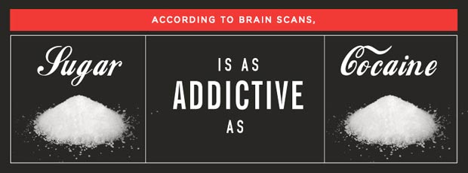


The neurobiology of food addiction
(the theory of compulsive overeating)
People may become addicted to addictive substances such as nicotine and alcohol but research indicates that people can also become addicted to sugar.
Sugar addicts experience the same withdrawal symptoms seen with those addicted to classic drugs of abuse when they are deprived of their drug.
Discuss factors related to overeating and the development of obesity

Slide 16
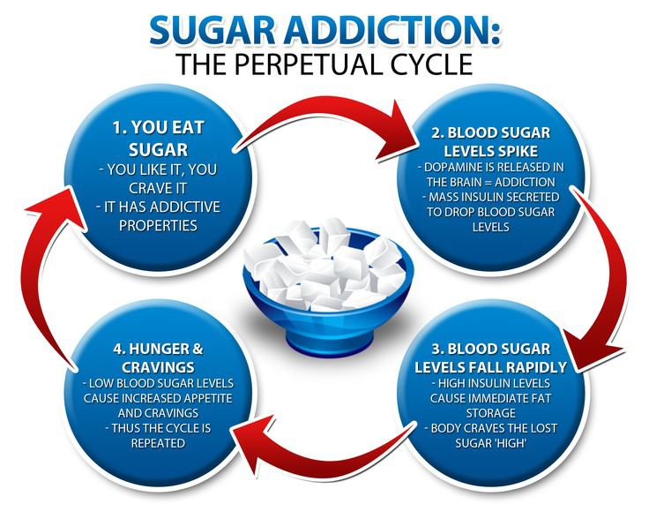

The neurobiology of food addiction
(the theory of compulsive overeating)
Kesler (2009) argues in his book The End of Overeating that manufactured food contains high amounts of sugar, fat, and salt that naturally stimulate the brain to release dopamine.
Such foods are experienced as pleasurable and the brain gets wired so that dopamine pathways are activated by specific cues (or stimuli) such as smells, the sign of a fast-food restaurant or the mere thought of the preferred food.
Discuss factors related to overeating and the development of obesity

Slide 17

Sociocultural factors of Obesity
Discuss factors related to overeating and the development of obesity

Slide 18
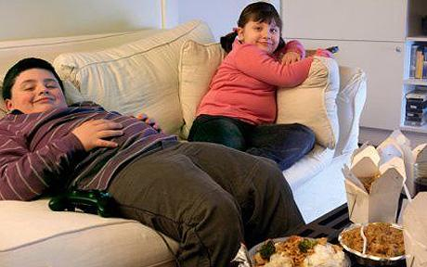

Sedentary lifestyle and change in eating patterns
Jeffery (2001) argues that the current epidemic of obesity is caused by lack of physical activity (i.e. sedentary lifestyle due to the use of cars and increased television viewing) and eating behavior (e.g. eating processed food high in energy).
Discuss factors related to overeating and the development of obesity

Slide 19


Sedentary lifestyle and change in eating patterns
Prentice and Jebb (1995) examined changes in physical activity in a British sample.
There was a positive correlation between increase in obesity and car ownership and television viewing.
The data supports the idea of a relationship between sedentary lifestyle and increase in obesity rates but correlational research cannot establish a cause -effect relationship.
Discuss factors related to overeating and the development of obesity

Slide 20
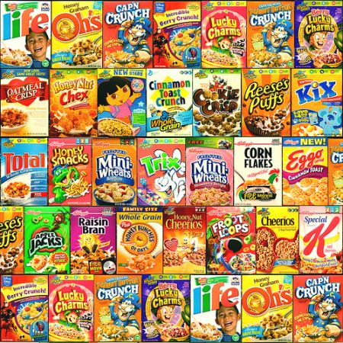

Food promotion and eating behavior
a possible cause of obesity in the way the food industry use food packaging to present products as “fun food”.
Discuss factors related to overeating and the development of obesity

Slide 21

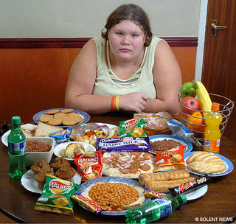
Socioeconomic factors of obesity
Research shows a consistent link between low socioeconomic status and high rates of obesity.
Discuss factors related to overeating and the development of obesity

Slide 22


Socioeconomic factors of obesity
Petersen (2006) found an increased polarization in regard to health.
People with higher education eat more healthy food and exercise more.
They are also more likely to respond positively to recommendations from health campaigns on how to stay healthy.
Discuss factors related to overeating and the development of obesity

Slide 23

Cognitive factors of obesity
People who diet typically replace physiological hunger sensations with “cognitive restraint”, i.e. they put a limit on what they can eat.
Discuss factors related to overeating and the development of obesity

Slide 24


Cognitive factors of obesity
Restraint theory predicts that extreme cognitive restraint is likely to make an individual more responsive to external cues (e.g. smell of food) or emotional events (e.g. stress or feeling down because weight loss is very small).
They often experience a “loss of control” that ends in overeating.
Discuss factors related to overeating and the development of obesity

Slide 25

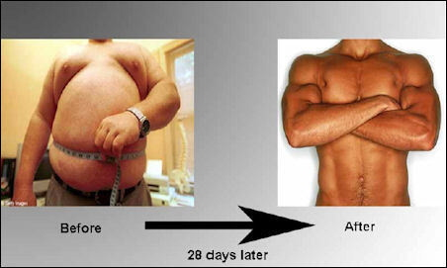
Cognitive factors of obesity
This is partly explained in terms of the false hope syndrome (Polivy, 2001).
It seems that obese dieters often set unrealistic goals and are overly optimistic as to how quickly they can lose weight.
Discuss factors related to overeating and the development of obesity

Slide 26



Cognitive factors of obesity
They may believe that weight loss will result in more radical changes in their lives than can rationally be expected.
This cocktail of false hopes and unrealistic criteria for success could be an explanation for lack of success in dieting and ultimately obesity.
Discuss factors related to overeating and the development of obesity

Slide 27


